Slide 1

Looking Below the Surface
Proposing Explanations

Slide 2
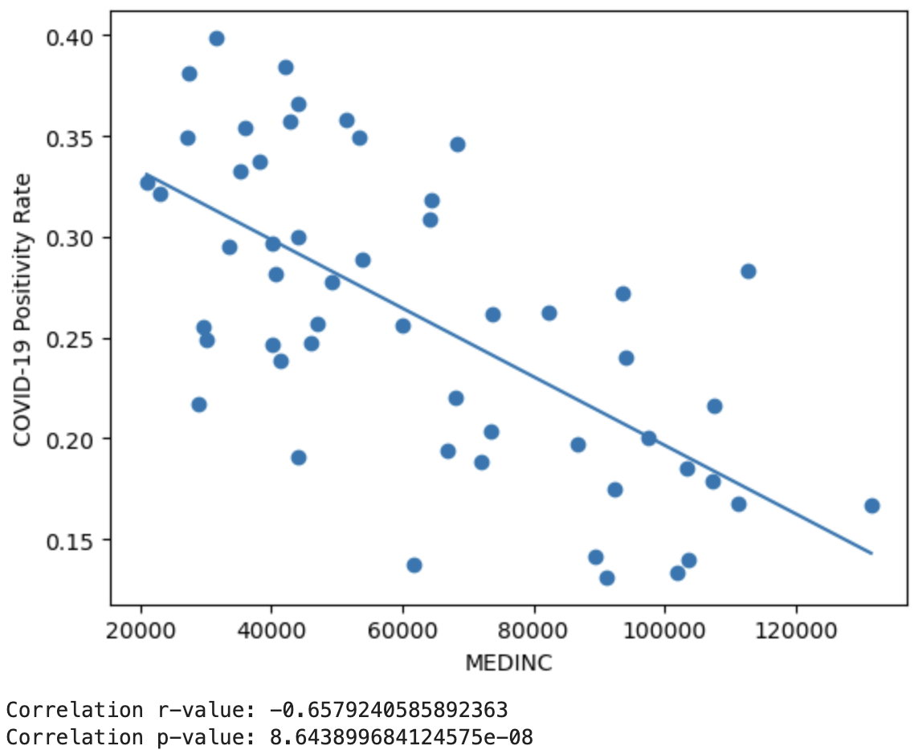
Notes:
Slide 2: Show the scatterplot of positivity rate vs. median income and point out that there is a very strong correlation between the two. The p-value is very small.

Slide 3
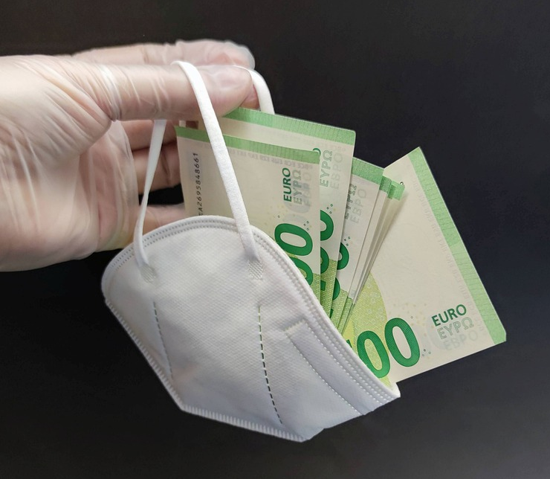
?
Notes:
Slide 3: Jokingly ask, “Does this mean money protects you from Covid?” Students will respond, “No” but a few may point out that, in a way, having higher income does provide people with certain things that are directly protective of Covid.
Ask students to dive deeper into this idea and propose examples of where a higher income carries with it, certain benefits that may protect one from Covid. Field responses.

Slide 4
$
Access to good healthcare
Access to personal transportation
Ability to quarantine
Educational attainment
Access to high-quality food
Notes:
Slide 4: After the student brainstorm, show a few examples. Explain that this is far from a complete list. In fact, income, as we all know, affects countless outcomes in our society.

Slide 5
Median Income is a “Proxy” Variable
Sometimes good: can be used in the place of a variable that you cannot measure
Sometimes bad: hides the true causal factors, can be used to generalize and promote stereotypes
Notes:
Slide 5: Explain that median income is what is known as a “proxy” variable. Proxy variables are surface-level variables that often do not have a direct role in the mechanism but can be highly correlated with the outcome. This is because, the proxy stands in for, or is connected to, many variables that are directly linked to the mechanism.
Proxy variables can be dangerous in that they can be used to make broad generalizations and stereotypes about people that do not get at the root cause of a problem.
However, proxy variables can also be used when data for the variables are “under their umbrella”. However, data scientists need to be very careful when using proxies and clear in why and how they are using them.

Slide 6
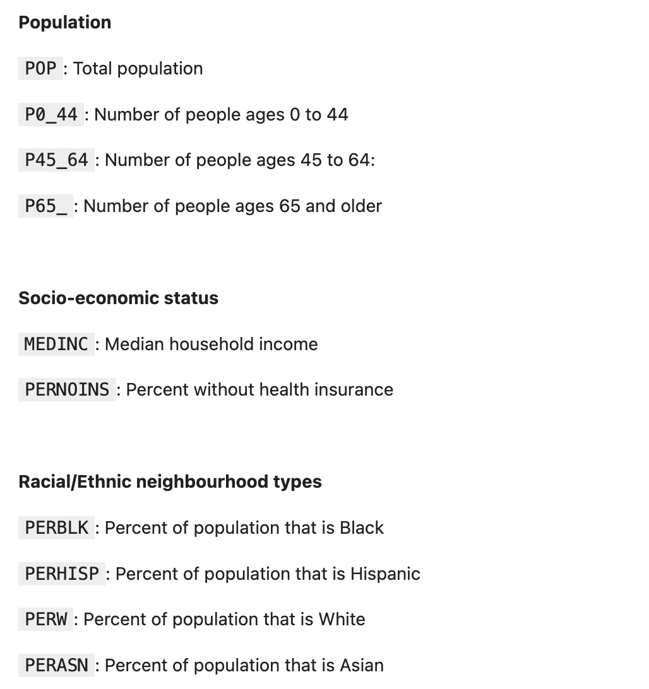
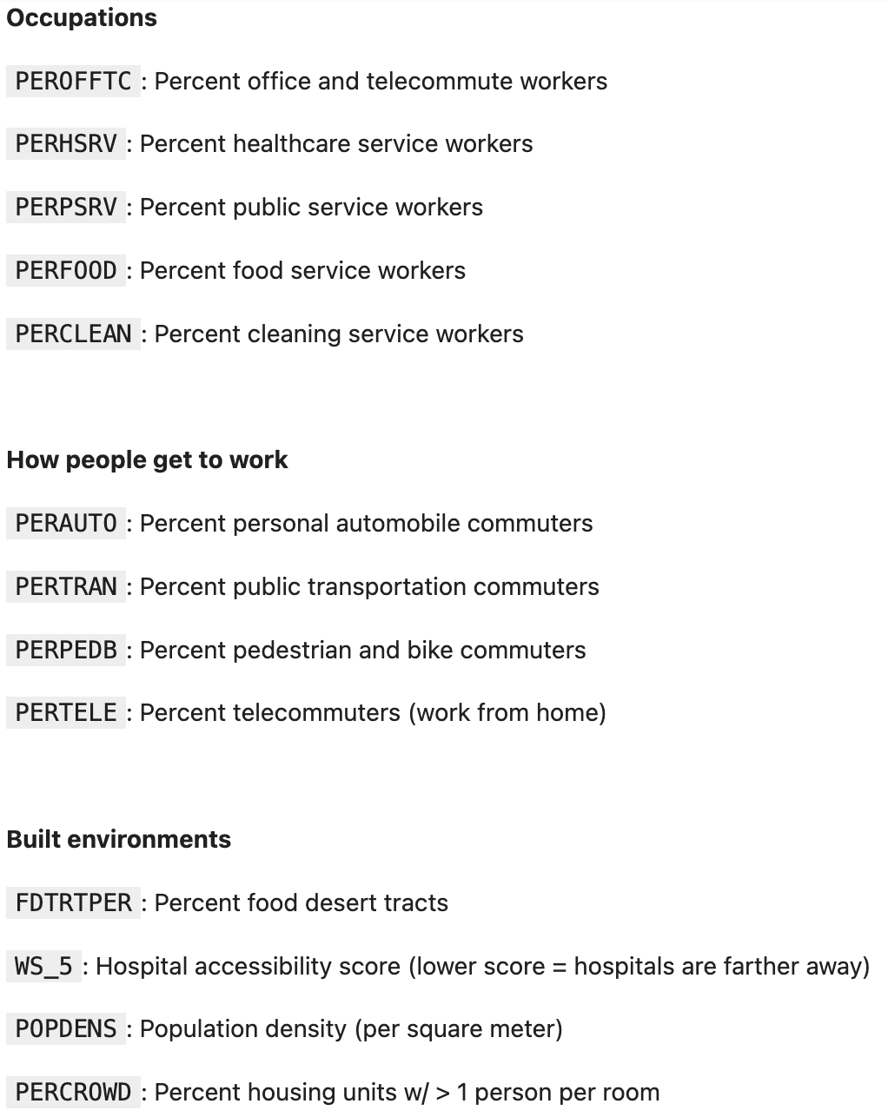
Which are the variables that stand in as proxies for a mechanism to get Covid – and which are more directly related to a mechanism?

Slide 7
Which are the variables that stand in as proxies for a mechanism to get Covid – and which are more directly related to a mechanism?

Slide 8
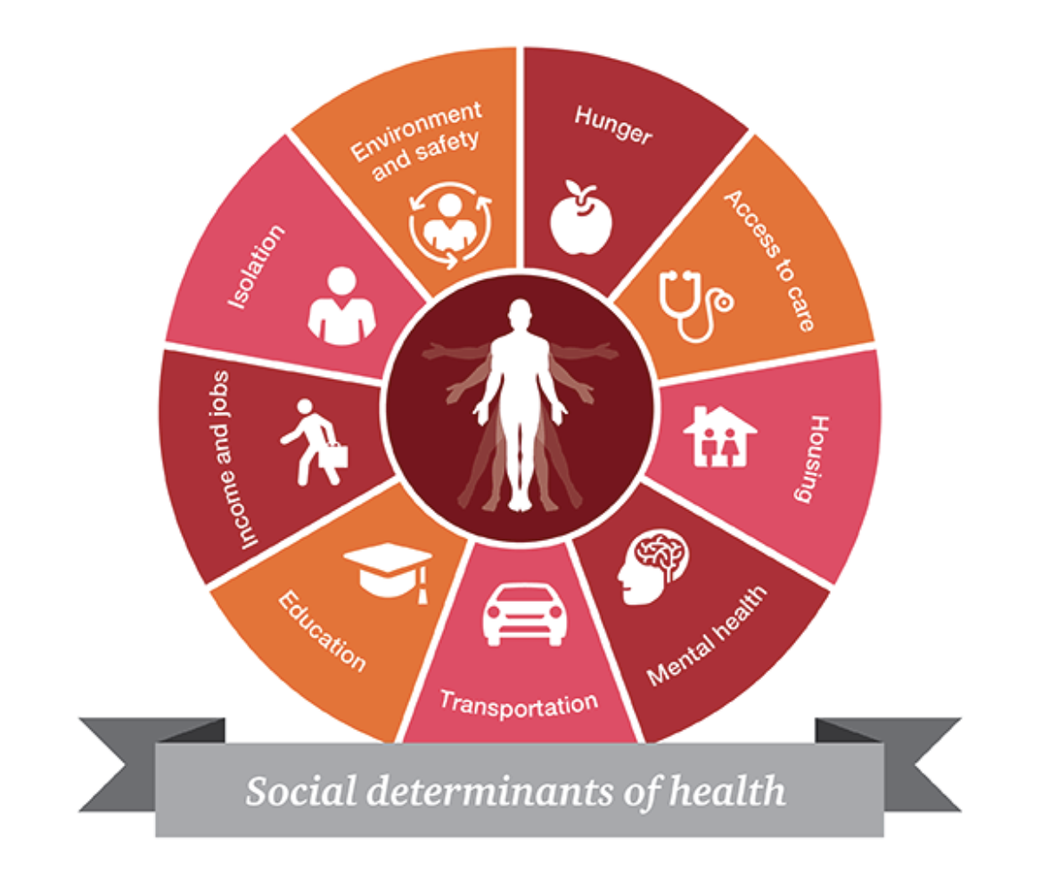
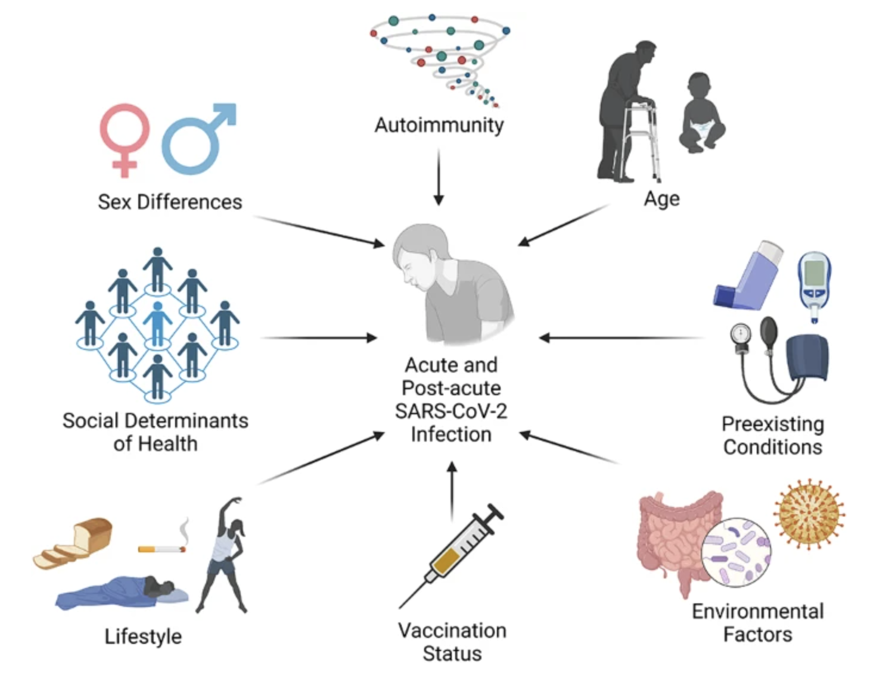
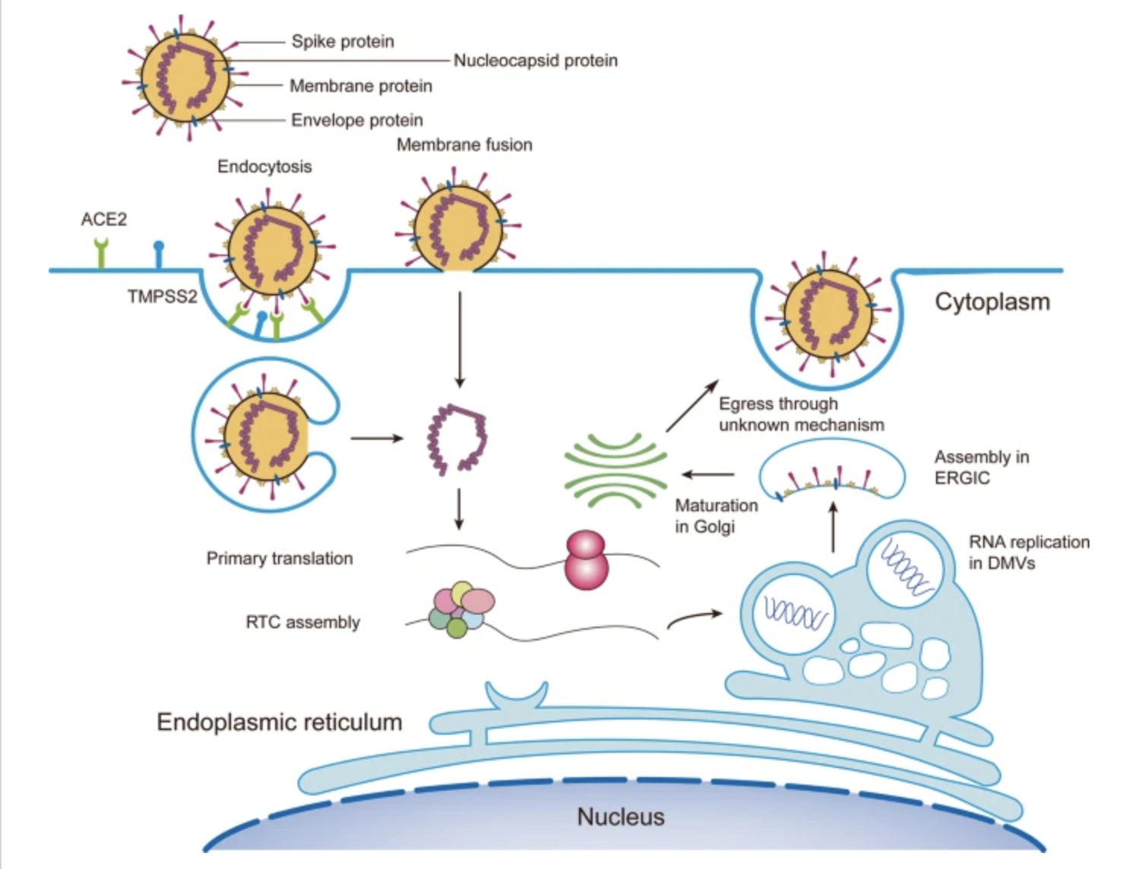
Covid-19 Explanatory Mechanisms at Different Scales
Social determinants of health
Risk factors at the individual level
Mechanisms at the microbiological scale
https://hitconsultant.net/2019/03/18/social-determinants-of-health-sdoh-collection/
https://virologyj.biomedcentral.com/articles/10.1186/s12985-023-02061-8
https://www.nature.com/articles/s41392-023-01510-8

Slide 9
In your groups…
Develop proposed explanation for the question:
“Why has Covid affected some communities more than others?”
Choose one explanatory variable that will help you test your proposed explanation.

